Slide 1
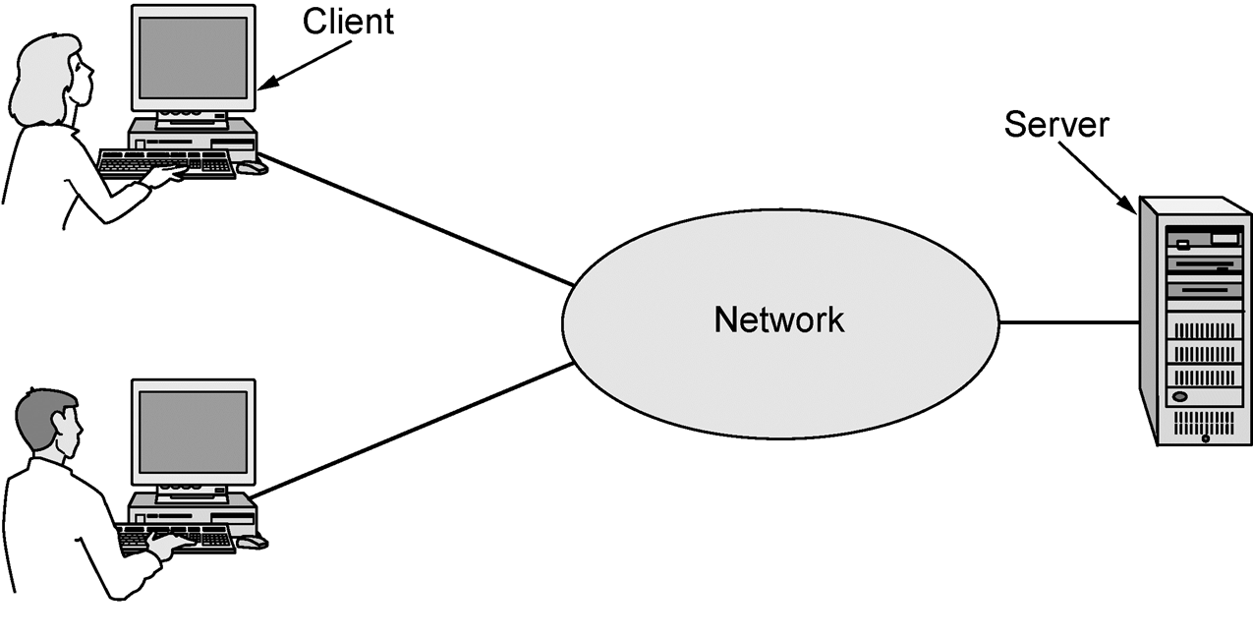
Focus of the course
???

Slide 2
Focus of the course (2)
Three “networking” topics:
We’re in the middle
Distributed systems
Networking
Communications

Slide 3
The Main Point
To learn how the Internet works »
What really happens when you “browse the web”?
What are TCP/IP, DNS, HTTP, NAT, VPNs, 802.11 etc. anyway?
To learn the fundamentals of computer networks

Slide 4
Why learn about the Internet?
Curiosity »
Impact on our world »
Job prospects!

Slide 5
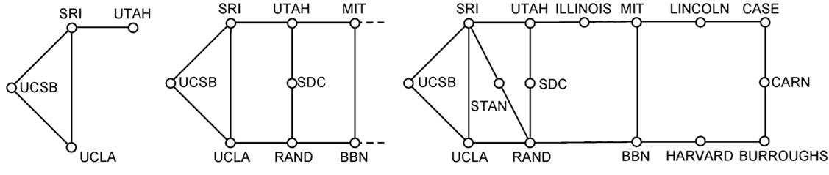
From this experimental network …
ARPANET ~1970
(a) Dec. 1969. (b) July 1970. (c) March 1971.

Slide 6
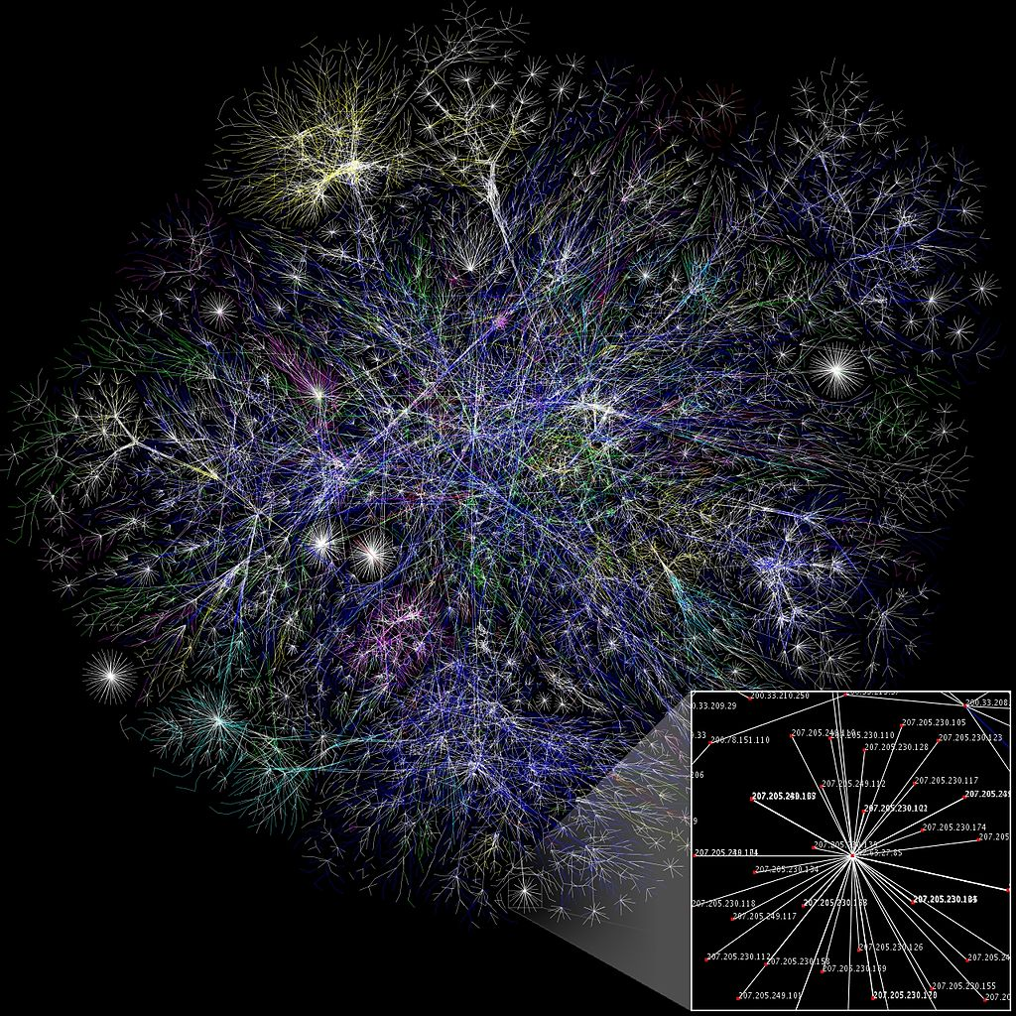
To this!
Internet
An everyday institution used at work, home, and on-the-go
Attribution: By The Opte Project [CC-BY-2.5], via Wikimedia Commons

Slide 7
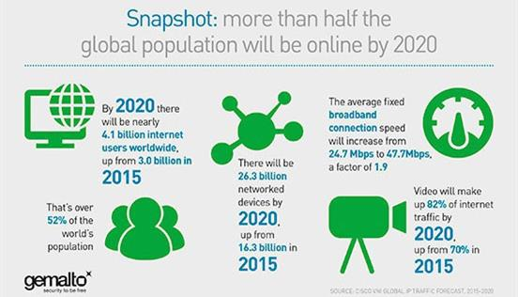

Slide 8




Internet – Societal Impact
An enabler of societal change
Easy access to knowledge
Electronic commerce
Personal relationships
Discussion without censorship

Slide 9




Internet – Economic impact
An engine of economic growth
Advertising-sponsored search
“Long tail” online stores
Online marketplaces
Crowdsourcing

Slide 10
The Main Point (2)
To learn how the Internet works
To learn the fundamentals of computer networks
What hard problems must they solve?
What design strategies have proven valuable?

Slide 11
Why learn the Fundamentals?
Apply to all computer networks
Intellectual interest »
Change / reinvention »

Slide 12
Fundamentals – Intellectual Interest
Example key problem: Reliability!
Any part of the Internet might fail
Messages might be corrupted
So how do we provide reliability?
Reliability solutions
Codes to detect/correct errors
Routing around failures ...

Slide 13
Fundamentals – Intellectual Interest (2)
Key problem | Example solutions
Reliability despite failures | Codes for error detection/correction Routing around failures
Network growth and evolution | Addressing and naming Protocol layering
Allocation of resources like bandwidth | Multiple access Congestion control
Security against various threats | Confidentiality of messages Authentication of communicating parties

Slide 14
Fundamentals – Reinvention
The Internet is constantly being re-invented!
Growth over time and technology trends drive upheavals in Internet design and usage »
Today’s Internet is different from yesterday’s
And tomorrow’s will be different again
But the fundamentals remain the same

Slide 15
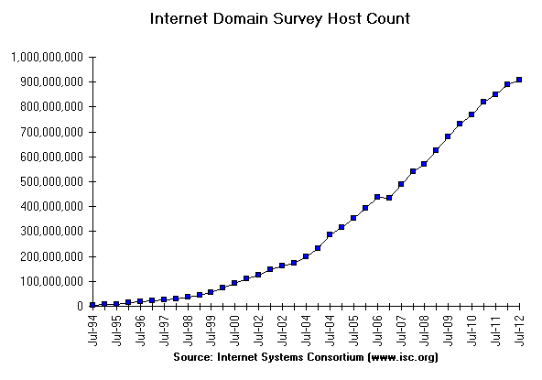
Fundamentals – Reinvention (2)
At least a billion Internet hosts and growing …
In January 2019, approximately 1.01 billion internet hosts were available on the DNS.

Slide 16
Fundamentals – Reinvention (3)
Examples of upheavals in the past 1-2 decades
Growth / Tech Driver | Upheaval
Emergence of the web | Content Distribution Networks
Digital songs/videos | Peer-to-peer file sharing
Falling cost/bit | Voice-over-IP calling
Many Internet hosts | IPv6
Wireless advances | Mobile devices

